Slide 1
Bluetooth Techniques
Chapter 10

Slide 2
Overview
Universal short-range wireless capability
Uses 2.4-GHz band
Available globally for unlicensed users
Devices within 10 m can share up to 720 kbps of capacity
Supports open-ended list of applications
  Data, audio, graphics, video

Slide 3
Bluetooth Application Areas
Data and voice access points
  Real-time voice and data transmissions (e.g. wireless headset)
Cable replacement
  Eliminates need for numerous cable attachments for connection (e.g. wireless keyboards, printers, etc)
Ad hoc networking
  Device with Bluetooth radio can establish connection with another when in range

Slide 4
Bluetooth Standards Documents
Core specifications
  Details of various layers of Bluetooth protocol architecture
Profile specifications
  Use of Bluetooth technology to support various applications
  A standard of interoperability (products from different vendors will work together for a given usage application)

Slide 5
Protocol Architecture
Bluetooth is a layered protocol architecture
  Core protocols
  Cable replacement and telephony control protocols
  Adopted protocols
Core protocols
  Radio – air interface, including frequency, frequency hopping, modulation scheme.
  Baseband – connection establishment, including addressing, packet format, timing
  Link manager protocol (LMP) – link management including security, negotiation of packet sizes
  Logical link control and adaptation protocol (L2CAP)– adapts upper-layer protocols to the baseband layer.
  Service discovery protocol (SDP) – device info, services and their characteristics are queried to enable the establishment of connection

Slide 6
Protocol Architecture
Cable replacement protocol
  RFCOMM –presents a virtual serial port, emulates EIA-232
Telephony control protocol
  Telephony control specification – binary (TCS BIN), for speech and data calls
Adopted protocols
  PPP
  TCP/UDP/IP
  OBEX – object exchange protocol (e.g. vCard and vCalendar, electronic business card, etc)
  WAE/WAP

Slide 7
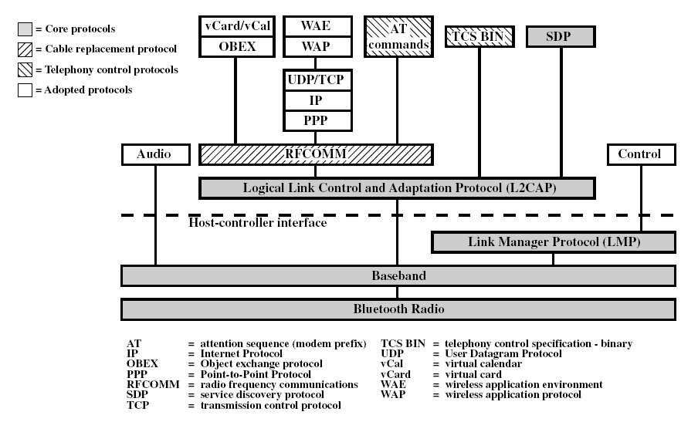
Protocol Stack

Slide 8
Usage Models
File transfer – documents, images, etc.
Internet bridge – cordless modem, dial-up networking
LAN access – devices on a piconet to access LAN
Synchronization – device-to-device sync. of personal information management
Three-in-one phone – cordless phone, intercom, or cellular phone
Headset

Slide 9
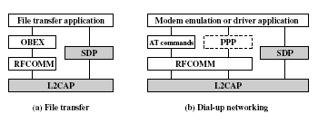
Usage Models

Slide 10
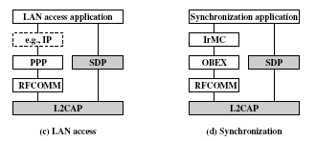
Usage Models

Slide 11
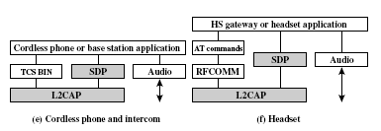
Usage Models

Slide 12
Piconets and Scatternets
Piconet
  Basic unit of Bluetooth networking
  Master and one to seven slave devices
  Master determines channel (frequency-hopping sequence) and phase (timing)
Scatternet
  Device in one piconet may exist as master or slave in another piconet
  Allows many devices to share same area
  Makes efficient use of bandwidth

Slide 13
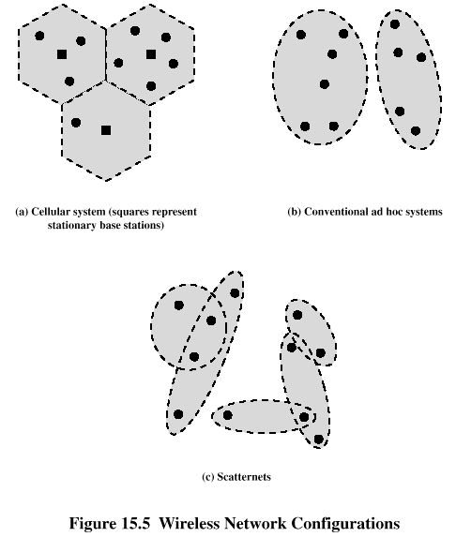
Wireless Network Configurations

Slide 14
Radio Specification
Bluetooth uses 2.4-GHz band within the ISM. It uses frequency-hopping scheme with a carrier spacing of 1MHz. (1-MHz physical channel)
Classes of transmitters
  Class 1: Outputs 100 mW for maximum range
    Power control mandatory
    Provides greatest distance
  Class 2: Outputs 2.4 mW at maximum
    Power control optional
  Class 3: Nominal output is 1 mW
    Lowest power

Slide 15
Frequency Hopping in Bluetooth
Provides resistance to interference and multipath effects
Provides a form of multiple access among co-located devices in different piconets

Slide 16
Frequency Hopping
Total bandwidth divided into 1MHz physical channels
FH occurs by jumping from one channel to another in pseudorandom sequence
Hopping sequence shared with all devices on piconet
Piconet access:
  Bluetooth devices use time division duplex (TDD)
  Access technique is TDMA
  FH-TDD-TDMA

Slide 17
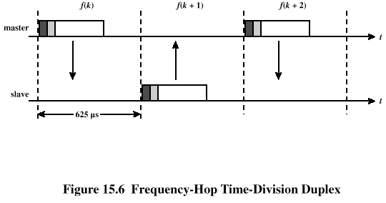
Frequency Hopping

Slide 18
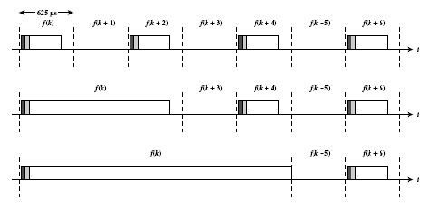
Multislot Frames

Slide 19
Physical Links between Master and Slave
Synchronous connection oriented (SCO)
  Allocates fixed bandwidth between point-to-point connection of master and slave
  Master maintains link using reserved slots
  Master can support three simultaneous links for the same slave
  For time-bounded data requiring guaranteed data rate
Asynchronous connectionless (ACL)
  Point-to-multipoint link between master and all slaves
  Only single ACL link can exist
  Data integrity is maintained (reduce errors)

Slide 20
Bluetooth Packet Fields
Access code – used for timing synchronization, offset compensation, paging, and inquiry
Header – used to identify packet type and carry protocol control information
Payload – contains user voice or data and payload header, if present
See figure 15.7

Slide 21
Types of Access Codes
Channel access code (CAC) – identifies a piconet
Device access code (DAC) – used for paging and subsequent responses
Inquiry access code (IAC) – used for inquiry purposes

Slide 22
Access Code
Preamble – used for DC compensation
  0101 if LSB of sync word is 0
  1010 if LSB of synch word is 1
Sync word – 64-bits, derived from:
  7-bit Barker sequence
  Lower address part (LAP)-- each Bluetooth device is assigned a unique 48-bit address, the last 24 bits are used here as LAP
  Pseudonoise (PN) sequence
Trailer
  0101 if MSB of sync word is 1
  1010 if MSB of sync word is 0

Slide 23
Packet Header Fields
AM_ADDR – contains “active mode” address (temporary address assigned to this slave in this piconet) of one of the slaves
Type – identifies type of packet (SCO, ACL, and common type)
Flow – 1-bit flow control
ARQN – 1-bit acknowledgment (ARQN=1 if reception is successful)
SEQN – 1-bit sequential numbering schemes (transmitted packets are alternatively labeled with a 1 or 0)
Header error control (HEC) – 8-bit error detection code

Slide 24
Payload Format
Payload header
  L_CH field – identifies logical channel
  Flow field – used to control flow at L2CAP level
  Length field – number of bytes of data
Payload body – contains user data
CRC – 16-bit CRC code

Slide 25
Error Correction Schemes
1/3 rate FEC (forward error correction)
  Used on 18-bit packet header, voice field in HV1 (SCO-type) packet
2/3 rate FEC
  Used in DM (Common-type) packets, data fields of DV (SCO-type) packet, FHS (Common-type) packet and HV2 (SCO-type) packet
ARQ
  Used with DM and DH (ACL-type) packets

Slide 26
ARQ Scheme Elements
Error detection – destination detects errors, discards packets
Positive acknowledgment – destination returns positive acknowledgment
Retransmission after timeout – source retransmits if packet unacknowledged
Negative acknowledgment and retransmission – destination returns negative acknowledgement for packets with errors, source retransmits

Slide 27
Channel Control
States of operation of a piconet during link establishment and maintenance
Major states
  Standby – default state, a low-power state
  Connection – device connected to a piconet as a master or a slave

Slide 28
Channel Control
Interim substates for adding new slaves
  Page – device issued a page (used by master)
  Page scan – device is listening for a page with its own device access code (DAC)
  Master response – master receives a page response from slave
  Slave response – slave responds to a page from master
  Inquiry – device has issued an inquiry for identity of devices within range
  Inquiry scan – device is listening for an inquiry
  Inquiry response – device receives an inquiry response

Slide 29
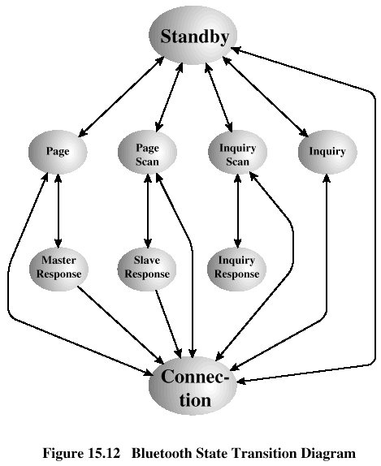
State Transition Diagram

Slide 30
Inquiry Procedure
Potential master identifies devices in range that wish to participate
  Transmits ID packet with inquiry access code (IAC)
  Occurs in Inquiry state
Device receives inquiry
  Enter Inquiry Response state
  Returns FHS packet with address and timing information
  Moves to page scan state

Slide 31
Page Procedure
Master uses devices address to calculate a page frequency-hopping sequence
Master pages with ID packet and device access code (DAC) of specific slave
Slave responds with DAC ID packet
Master responds with its FHS packet (contains device address and real-time clock value)
Slave confirms receipt with DAC ID
Slaves moves to Connection state

Slide 32
Slave Connection State Modes
Active – participates in piconet
  Listens, transmits and receives packets
Sniff – only listens on specified slots
Hold – does not support ACL packets
  Reduced power status
  May still participate in SCO exchanges
Park – does not participate on piconet
  Still retained as part of piconet

Slide 33
L2CAP
Provides a link-layer protocol between entities with a number of services
Relies on lower layer for flow and error control
Makes use of ACL links, does not support SCO links
Provides two alternative services to upper-layer protocols
  Connectionless service
  Connection-mode service

Slide 34
L2CAP Logical Channels
Connectionless
  Supports connectionless service
  Each channel is unidirectional
  Used from master to multiple slaves (broadcast)
Connection-oriented
  Supports connection-oriented service
  Each channel is bidirectional (full duplex)
Signaling
  Provides for exchange of signaling messages between L2CAP entities
See figure 15.14

Slide 35
Signaling Packet Payload
Consists of one or more L2CAP commands, each with four fields
  Code – identifies type of command
  Identifier – used to match request with reply
  Length – length of data field for this command
  Data – additional data for command, if necessary

